Slide 1
SP-IMLA
STROKE PREDICTION USING AN INTEGRATED MACHINE LEARNING APPROACH
MRITUNJAY MEHTA
ASHIMA GARG

Slide 2
INTRODUCTION
According to the World Health Organization (WHO) stroke is the 2nd leading cause of death globally, responsible for approximately 11% of total deaths.
First what is a stroke?
• Stroke is a medical emergency. A stroke occurs when blood flow to a part of your brain is interrupted or reduced, preventing brain tissue from getting oxygen and nutrients. Brain cells begin to die within minutes.

Slide 3
Risk Factors
• Age: People aged 55 years and over
• Hypertension: if the systolic pressure is 140 mm Hg or more, or the diastolic pressure is 90 mm Hg or more
• Hypercholesterolemia: If the cholesterol level in the blood is 200 milligrams per decilitre
• Smoking
• Diabetes
• Obesity: if the body mass index (BMI) is 30 or more

Slide 4
MOTIVATION
Stroke is becoming an important cause of premature death and disability in low-income and middle-income countries like India, largely driven by demographic changes and enhanced by the increasing prevalence of the key modifiable risk factors. As a result, developing countries are exposed to a double burden of both communicable and noncommunicable diseases. The poor are increasingly affected by stroke, because of both the changing population exposures to risk factors and, most tragically, not being able to afford the high cost for stroke care. Majority of stroke survivors continue to live with disabilities, and the costs of on-going rehabilitation and long term-care are largely undertaken by family members, which impoverish their families. Being able to predict the possibility of a stroke is highly desirable for clinicians. This allows clinicians to set reasonable goals with patients and relatives, and to reach shared before-care decisions for recovery or rehabilitation.

Slide 5
Techniques/ Technologies used
Python
Skit-learn
Pandas
Matplotlib
Logistic Regression
K-Means Clustering
One hot encoding
Jupyter Notebook
Some other basic data science knowledge

Slide 6
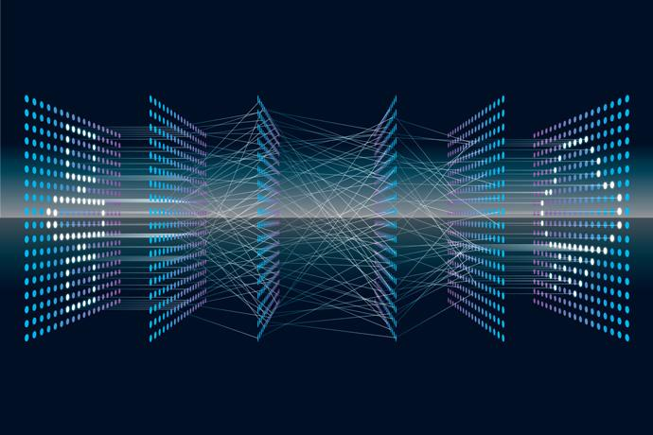

Facilities Required
System Requirements for the proposed work
Ram: minimum 8-16 Gb
CPU: Intel Corei5 7 th Generation or more is preferred.
Storage: minimum 256gb or more (1TB preferred).
HIGH SPEED INTERNET CONNECTIVITY is preferred

Slide 7
Methodology / Planning of Work
01
Exploratory Data Analysis and Cleaning
02
Using logistic regression & Kmeans Clustering Algorithms to accurately predict stroke occurrence using dataset.
03
Confusion Matrix for each & every algorithms for better future analysis & comparison.
04
Collection, Representation, Proper documentation & Integration of Data & results found

Slide 8
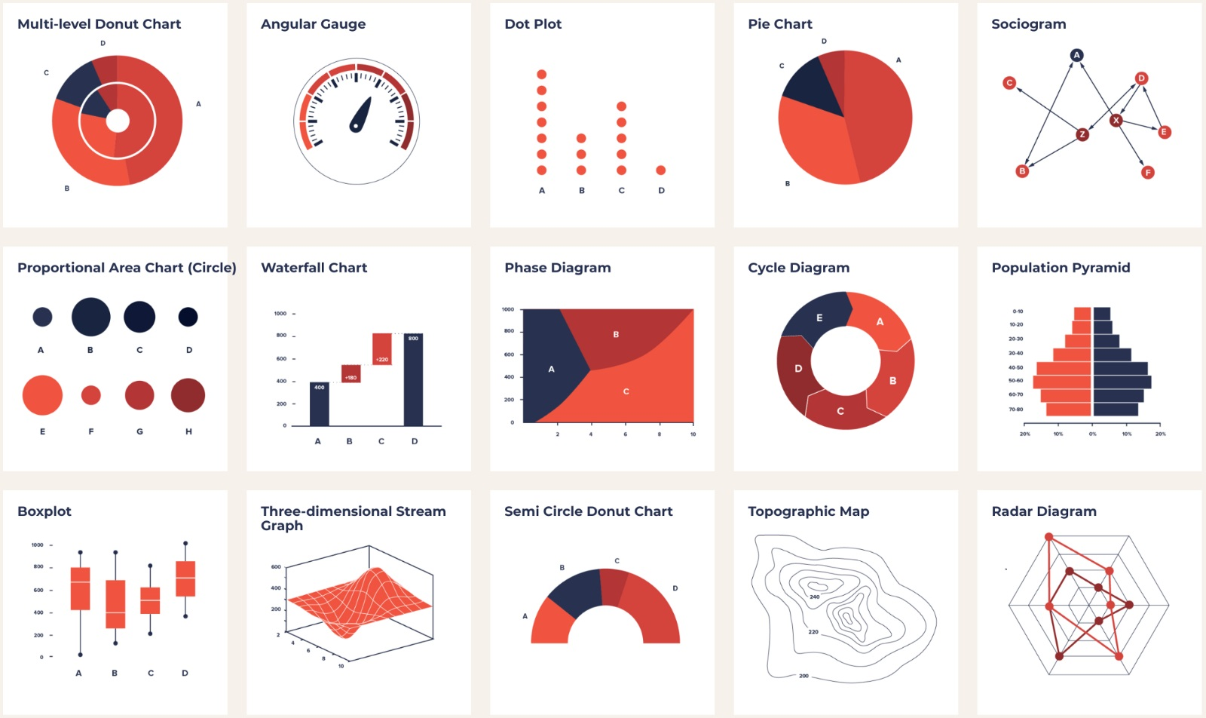
Exploratory Data Analysis
Exploratory Data Analysis refers to the critical process of performing initial investigations on data so as to discover patterns,to spot anomalies,to test hypothesis and to check assumptions with the help of summary statistics and graphical representations.
It is a good practice to understand the data first and try to gather as many insights from it. EDA is all about making sense of data in hand,before using that data for analysis.

Slide 9
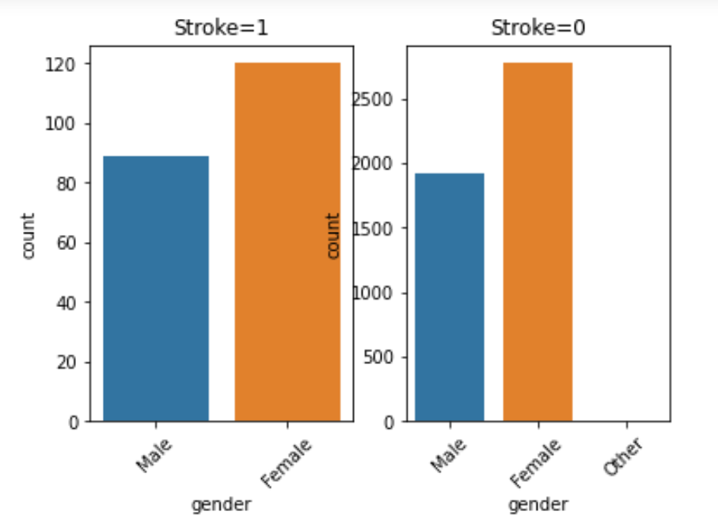
Gender
Observations based on….
4.52%
3.97%
Stroke 1
95.47%
96.03%
Stroke 0
Men are more prone to strokes than women
Men
Women

Slide 10
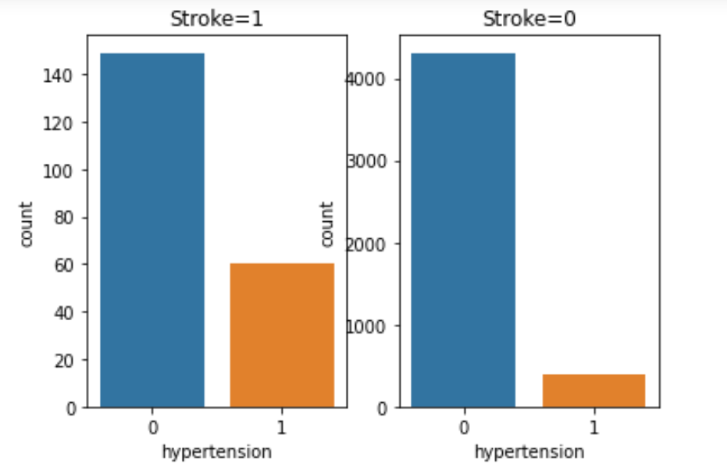
Hypertension
Observations based on….
3.37%
16.66%
Stroke 1
96.62%
83.33%
Stroke 0
People having hypertension are more prone to strokes.
0
1

Slide 11
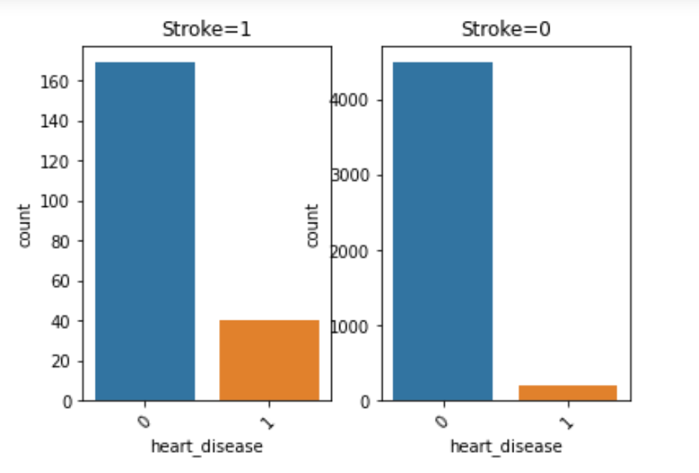
Heart Disease
Observations based on….
3.64%
28.57%
Stroke 1
96.35%
71.42%
Stroke 0
People having heart disease are are very much likely to develop stroke attacks.
0
1

Slide 12
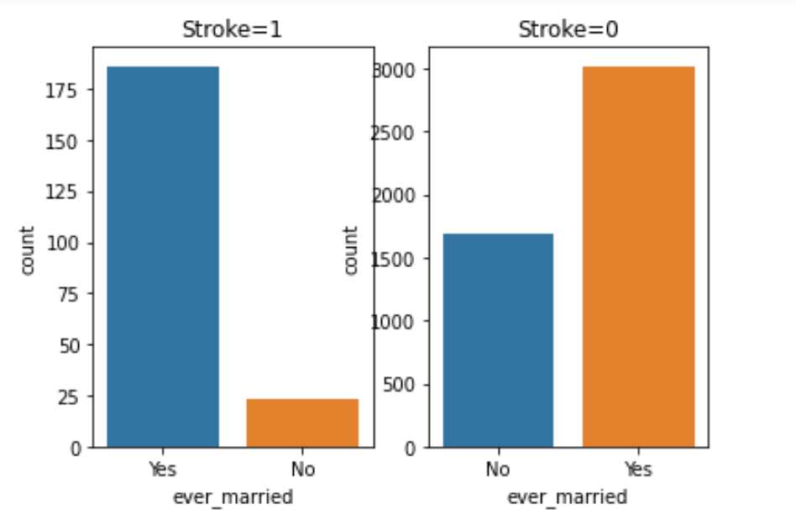
Ever Married
Observations based on….
9.56%
0.82%
Stroke 1
90.43%
99.17%
Stroke 0
Married people are more prone to have stroke attacks.
Yes
No

Slide 13
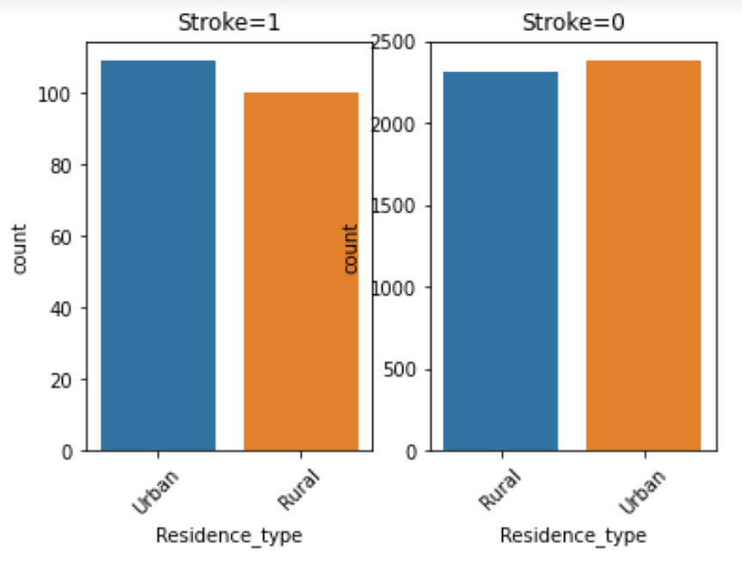
Residence Type
Observations based on….
4.38%
4.07%
Stroke 1
95.62%
95.93%
Stroke 0
Residence type doesn’t show much variation in stroke attacks.
Stroke attacks are slightly more likely to happen in urban areas than rural areas.
Urban
Rural

Slide 14
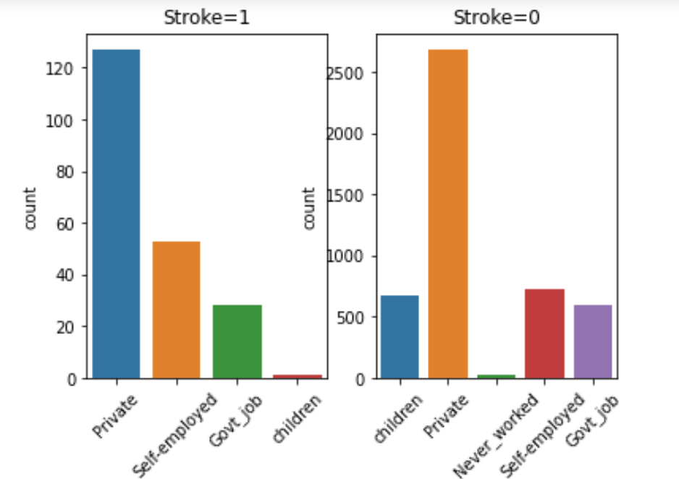
Job Type
Observations based on….
15.66%
1.81%
5.66%
Stroke 1
84.33%
98.18%
94.33%
Stroke 0
People having private jobs are most prone to have stroke attacks followed by people having Govt-jobs.
People who are self employed are least prone to have stroke attacks.
Private
Self - employed
Govt-job

Slide 15
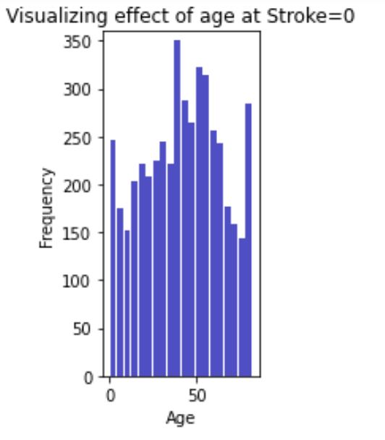
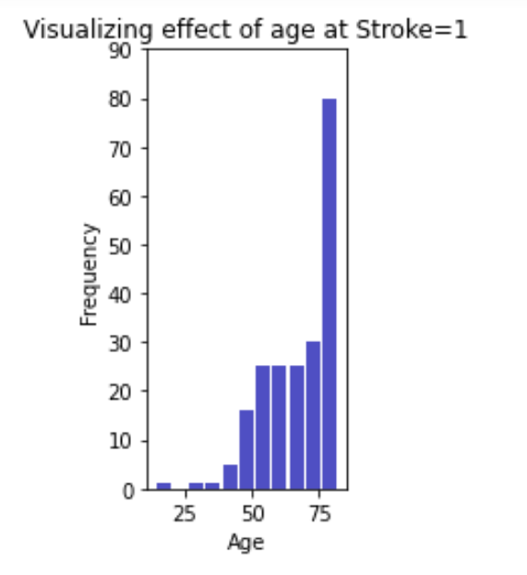
Age
Observations based on….
Notice that…
People below age 25 are least prone to strokes.
People above age 75 are more prone to strokes.
Stroke 0
Stroke 1

Slide 16
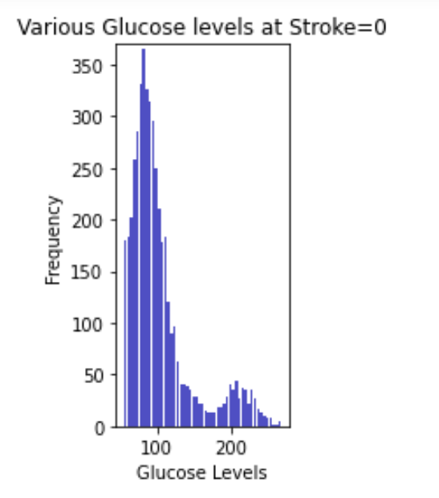
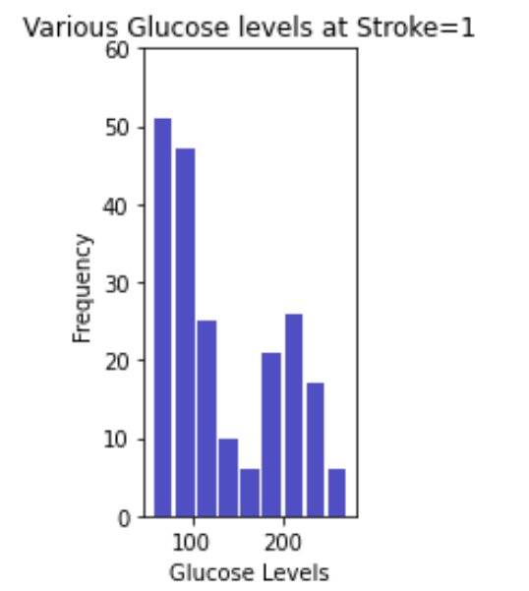
Glucose Levels
Observations based on….
Notice that…
People having lower glucose level are more prone to strokes.
People having higher glucose levels are less prone to strokes.
Stroke 0
Stroke 1

Slide 17
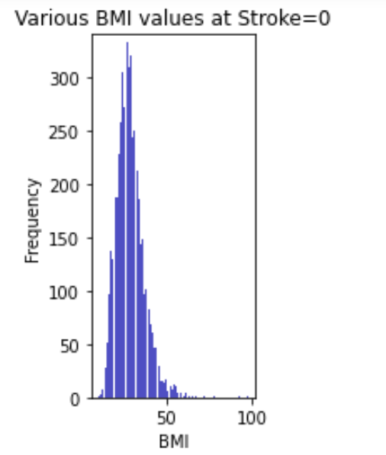
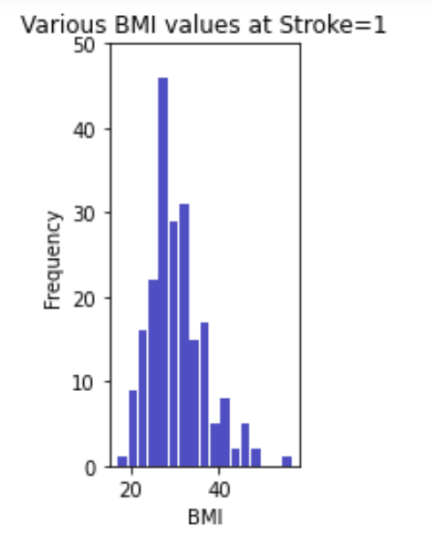
BMI
Observations based on….
Notice that…
People having BMI (body mass index) between 20-40 are most prone to strokes as comparatively to other people
Stroke 0
Stroke 1

Slide 18
Why One-Hot Encode Data in Machine Learning?
Categorical data are variables that contain label values rather than numeric values.
The number of possible values is often limited to a fixed set.
Each value represents a different category.
Many machine learning algorithms cannot operate on label data directly. They require all input variables and output variables to be numeric.
In general, this is mostly a constraint of the efficient implementation of machine learning algorithms rather than hard limitations on the algorithms themselves.
This means that categorical data must be converted to a numerical form. If the categorical variable is an output variable, you may also want to convert predictions by the model back into a categorical form in order to present them or use them in some application.

Slide 19

One-hot Encoding
One hot encoding is a process by which categorical variables are converted into a form that could be provided to ML algorithms to do a better job in prediction.
It is the most widespread approach, and it works very well unless your categorical variable takes on a large number of values.
It creates new (binary) columns, indicating the presence of each possible value from the original data.

Slide 20
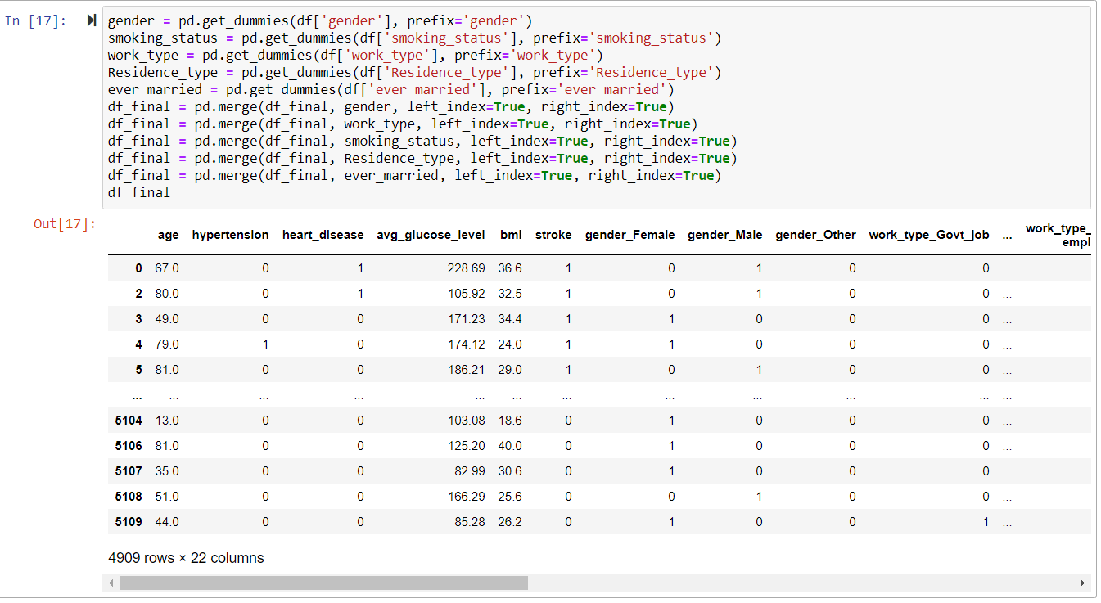
One-hot Encoding

Slide 21
One-hot Encoding

Slide 22
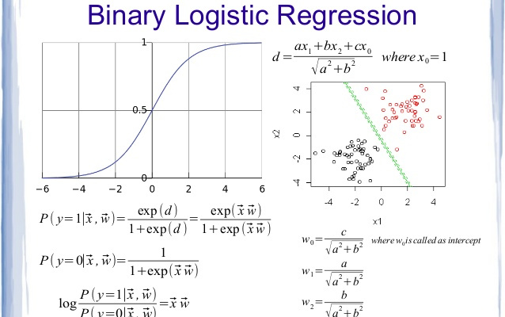
Logistic Regression
Logistic regression is a statistical model that in its basic form uses a logistic function to model a binary dependent variable, although many more complex extensions exist.
In regression analysis, logistic regression (or logit regression) is estimating the parameters of a logistic model (a form of binary regression).

Slide 23
Application : Logistic Regression
Logistic regression is used in various fields, including machine learning, most medical fields, and social sciences.
Logistic regression may be used to predict the risk of developing a given disease (e.g. diabetes; coronary heart disease), based on observed characteristics of the patient (age, sex, body mass index, results of various blood tests, etc.).

Slide 24

Logistic Regression
Pros Cons
Simple to implement.
Effective
Feature scaling not needed:
Does not require input features to be scaled (can work with scaled features too, but doesn’t require scaling)
Tuning of hyperparameters not needed.
Poor performance on non-linear data (image data for e.g.)
Poor performance with irrelevant and highly correlated features
Not very powerful
High reliance on proper presentation of data.
All the important variables / features should be identified for it to work well.

Slide 25
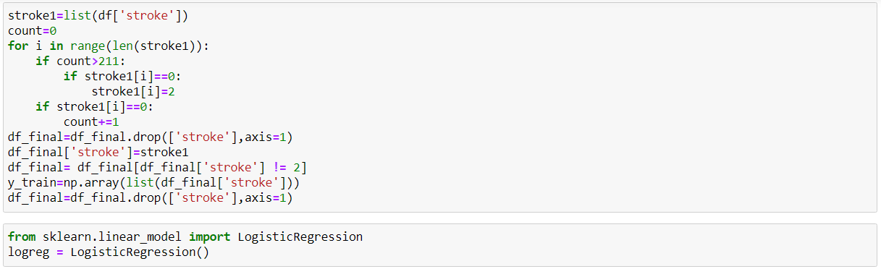
Logistic Regression

Slide 26
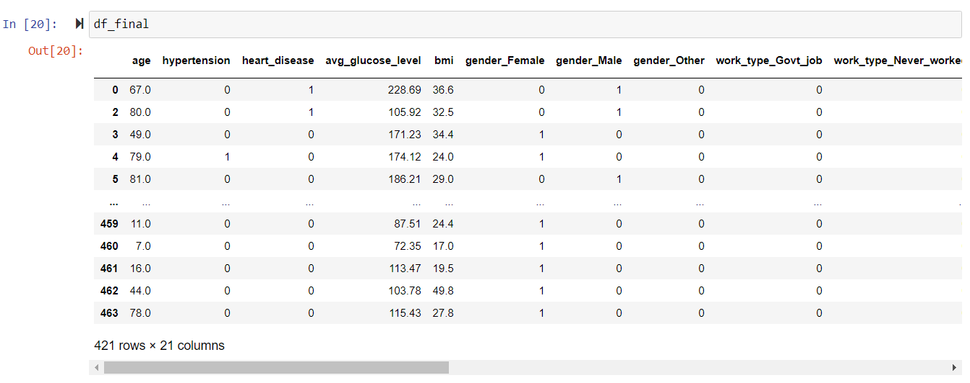
Logistic Regression

Slide 27
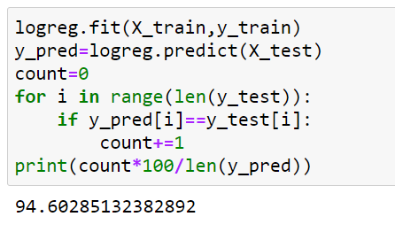
Logistic Regression
Accuracy came out to be 94.60%.

Slide 28
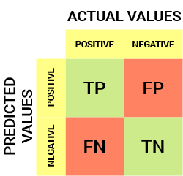
Confusion Matrix
A Confusion matrix is an N x N matrix used for evaluating the performance of a classification model, where N is the number of target classes. The matrix compares the actual target values with those predicted by the machine learning model. This gives us a holistic view of how well our classification model is performing and what kinds of errors it is making.

Slide 29
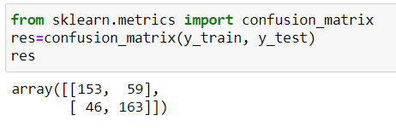
Confusion Matrix

Slide 30
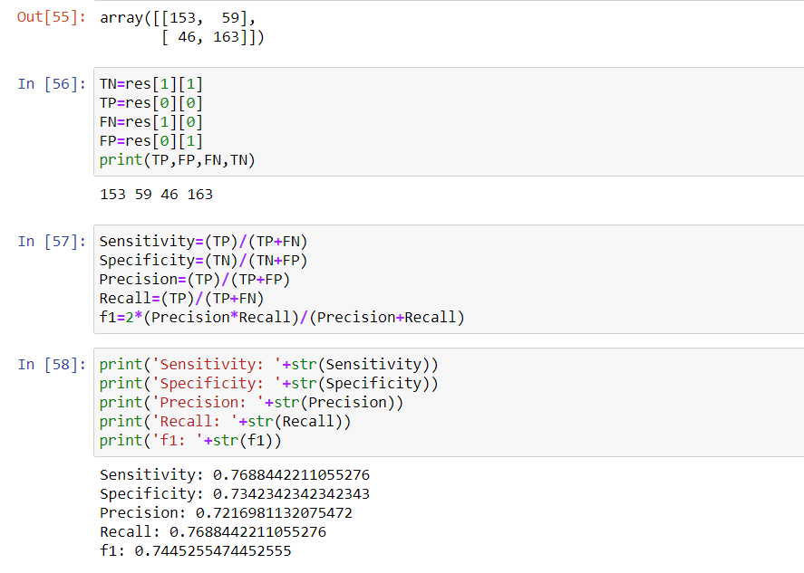
Confusion Matrix

Slide 31
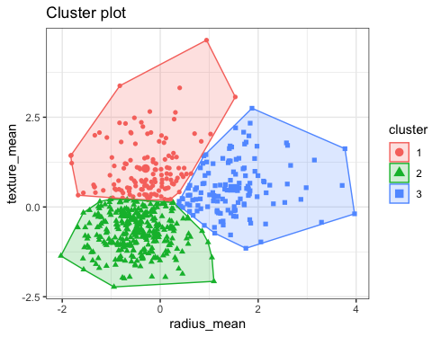
K-Means Clusturing
K means is one of the most popular Unsupervised Machine Learning Algorithms Used for Solving Classification Problems.
K Means segregates the unlabeled data into various groups, called clusters, based on having similar features, common patterns.
A cluster refers to a collection of data points aggregated together because of certain similarities.

Slide 32
How it works
To process the learning data, the K-means algorithm in data mining starts with a first group of randomly selected centroids, which are used as the beginning points for every cluster, and then performs iterative (repetitive) calculations to optimize the positions of the centroids

Slide 33
How it works
It halts creating and optimizing clusters when either:
The centroids have stabilized — there is no change in their values because the clustering has been successful.
The defined number of iterations has been achieved.

Slide 34
K-Means Clustering
Pros Cons
Relatively simple to implement. Scales to large data sets. Guarantees convergence. Can warm-start the positions of centroids. Easily adapts to new examples. Generalizes to clusters of different shapes and sizes, such as elliptical clusters.
Choosing manually.
Being dependent on initial values.
Clustering data of varying sizes and density.
Clustering outliers.
Scaling with number of dimensions.

Slide 35
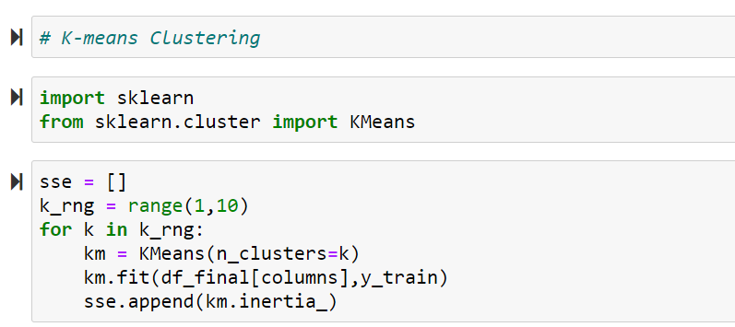
Finding “k”

Slide 36
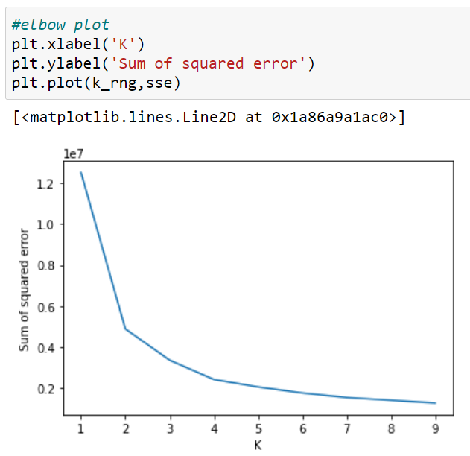
Elbow Plot (Finding “k”)

Slide 37
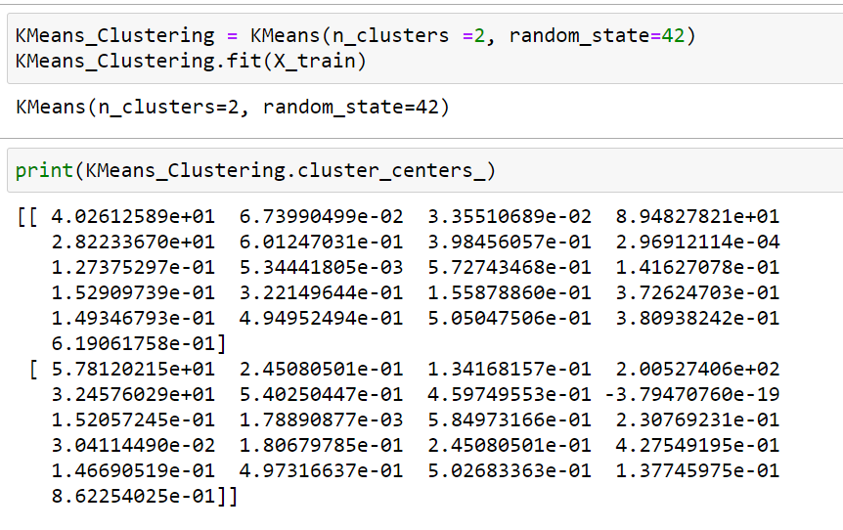
Training the Model

Slide 38
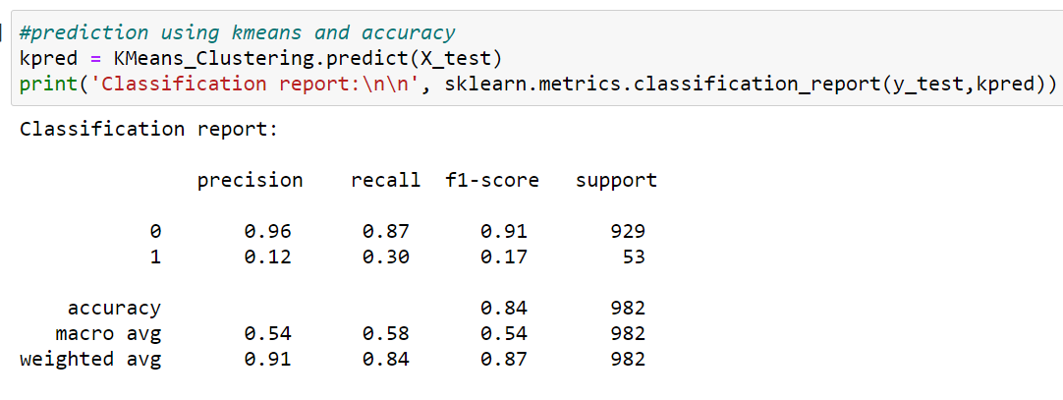
Classification Report

Slide 39
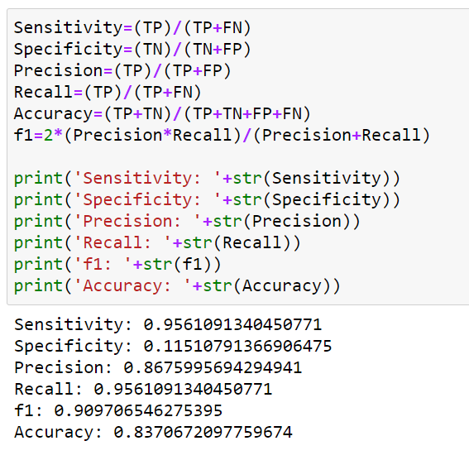
Confusion Matrix
Accuracy came out to be 83.70%.

Slide 40
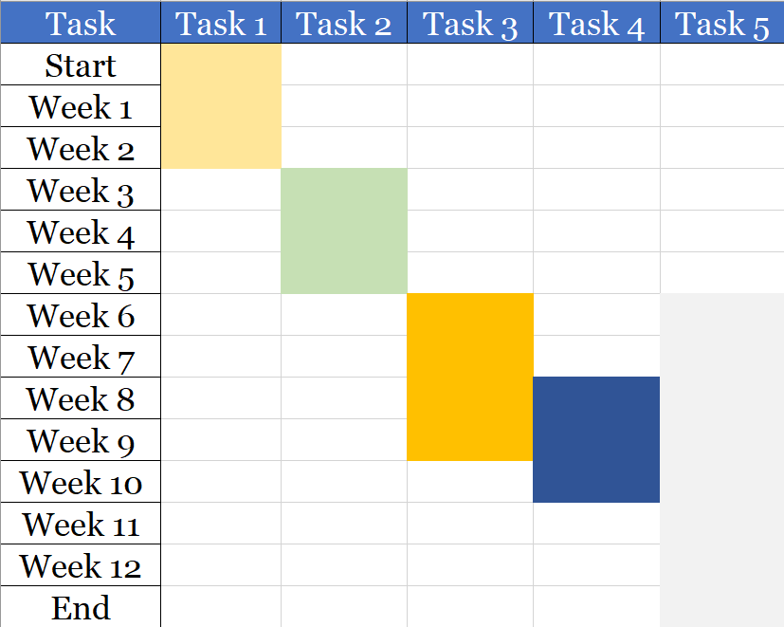
Project timeline
Gantt Chart :
TASK 1
TASK 2
TASK 3
TASK 4
TASK 5
Research about the project
Exploratory Data Analysis and Cleaning
Using various methods to accurately predict stroke occurrence using dataset
Collection & Representation of Data found
Proper Documentation & Integration

